Slide 1
Feedforward Neural Networks
Implementing Feedforward neural networks with Keras and TensorFlow

Slide 2
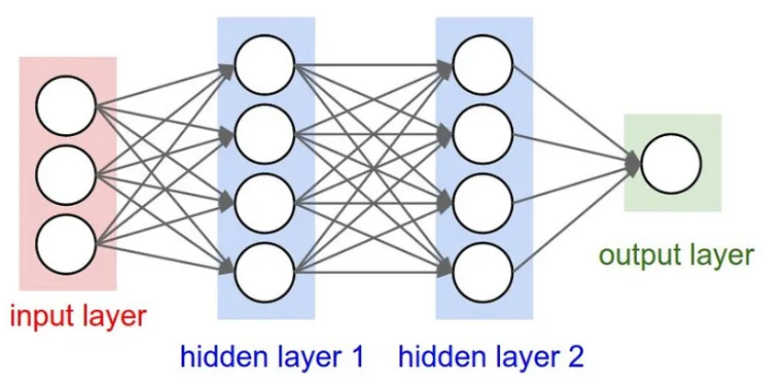
Neural Network
A neural network is a very powerful machine learning mechanism which basically mimics how a human brain learns. The brain receives the stimulus from the outside world, does the processing on the input, and then generates the output.

Slide 3
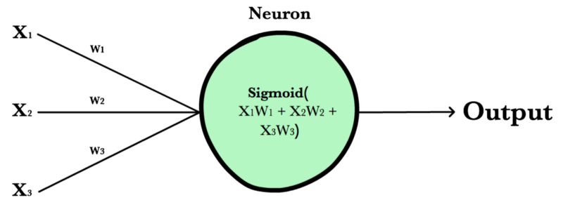

Slide 4
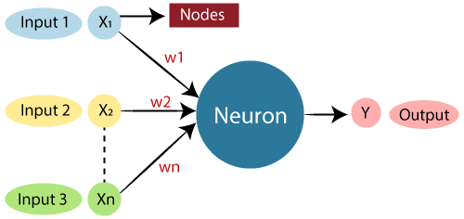

Slide 5
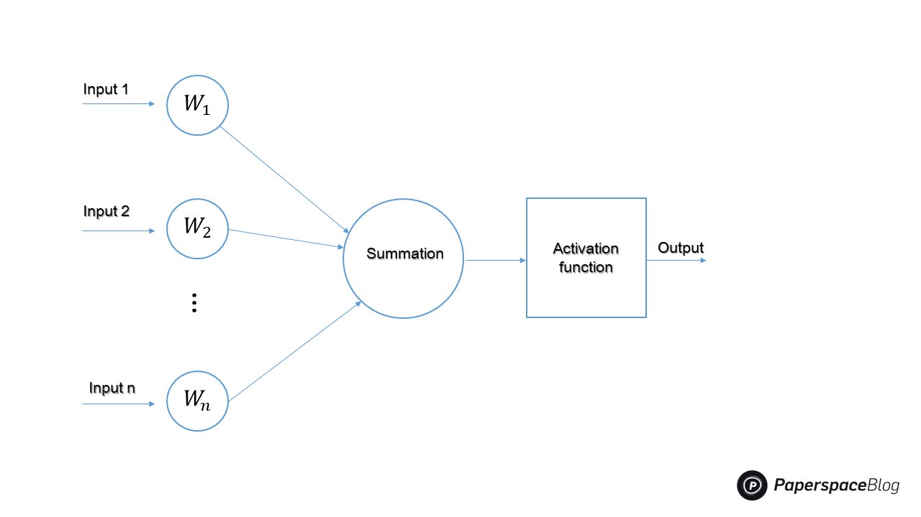
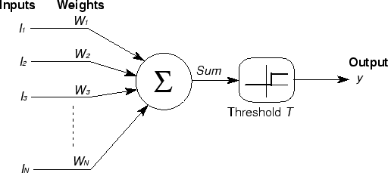

Slide 6
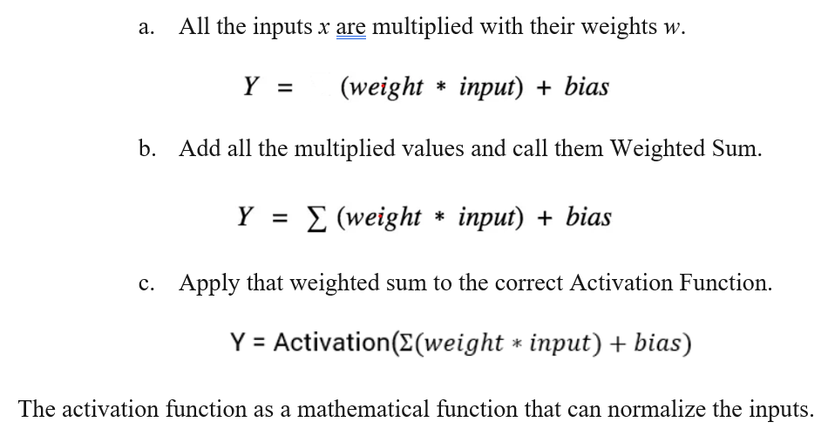
Working

Slide 7
Terminologies
Inputs: They can be viewed as features or attributes in a dataset. The input layer of the model receives the data that we introduce to it from external sources like a images or a numerical vector. It is the only layer that can be seen in the entire design of a neural network that transmits all of the information from the outside world without any processing.
Hidden Layers: They are intermediary layers that do all calculations and extract the features of the data. The search for hidden features in data may comprise many interlinked hidden layers. In image processing, for example, the first hidden layers are often in charge of higher-level functions such as detection of borders, shapes, and boundaries. The later hidden layers, on the other hand, perform more sophisticated tasks, such as classifying or segmenting entire objects
Output Layer: The final prediction is made by the output layer using data from the preceding hidden layers. It is the layer from which we acquire the final result, hence it is the most important. In the output layer, classification and regression models typically have a single node. However, it is fully dependent on the nature of the problem at hand and how the model was developed. Some of the most recent models have a two-dimensional output layer. For example, Meta's new Make-A-Scene model that generates images simply from a text at the input

Slide 8
Terminologies (Cont…)
Weights: weights are the real values that are attached with each input/feature and they convey the importance of that corresponding feature in predicting the final output. (will discuss about this in-detail in this article)
Bias: Bias is used for shifting the activation function towards left or right, you can compare this to y-intercept in the line equation. (will discuss more about this in this article)
Summation Function: The work of the summation function is to bind the weights and inputs together and calculate their sum.
Activation Function: It is used to introduce non-linearity in the model.

Slide 9
Activation Functions
Sigmoid
Tanh: Hyperbolic Tangent
ReLU: Rectified Linear Unit
Leaky ReLU
ELU (Exponential Linear Units):
Maxout:

Slide 10
Feedforward Artificial Neural Network
A feedforward Artificial Neural Network (ANN) is a type of neural network in which the information flows in only one direction,
from the input layer, through one or more hidden layers, to the output layer, without any feedback loops.
It is called "feedforward" because the data only moves forward through the network and never loops back on itself
In a feedforward ANN,
the input layer receives input data, and each neuron in the input layer is connected to the neurons in the next layer, the hidden layer.
The hidden layer can contain one or more layers, and each neuron in the hidden layer is connected to the neurons in the output layer.
The output layer produces the output for a given input.

Slide 11
Backpropagation
Backpropagation is a learning algorithm that adjusts the weights and biases of the neural network based on the error between the predicted output and the actual output.
The backpropagation algorithm consists of two phases: forward propagation and backward propagation.
During forward propagation, the input is fed into the neural network, and the network calculates the output. During backward propagation, the error between the predicted output and the actual output is calculated, and the weights and biases of each neuron are adjusted to reduce the error.
The backpropagation algorithm uses the gradient descent optimization method to update the weights and biases of the network. The gradient descent method calculates the gradient of the error function with respect to the weights and biases, and then updates the weights and biases in the direction of the negative gradient, which reduces the error.

Slide 12
Why GD???: Neural networks takes several inputs, processes it through multiple neurons from multiple hidden layers, and returns the result using an output layer. This result estimation process is technically known as “Forward Propagation“.
Next, we compare the result with actual output. Each of these neurons is contributing some error to the final output.
We try to minimize the value/ weight of neurons that are contributing more to the error and this happens while traveling back to the neurons of the neural network and finding where the error lies. This process is known as “Backward Propagation “.
In order to reduce this number of iterations to minimize the error, the neural networks use a common algorithm known as “Gradient Descent”, which helps to optimize the task quickly and efficiently.
Learning rate: gradient descent takes into the direction of the local minimum are determined by the learning rate, which figures out how fast or slows we will move towards the optimal weights.

Slide 13
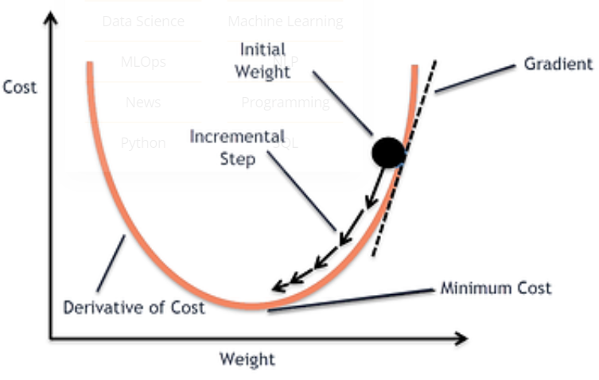
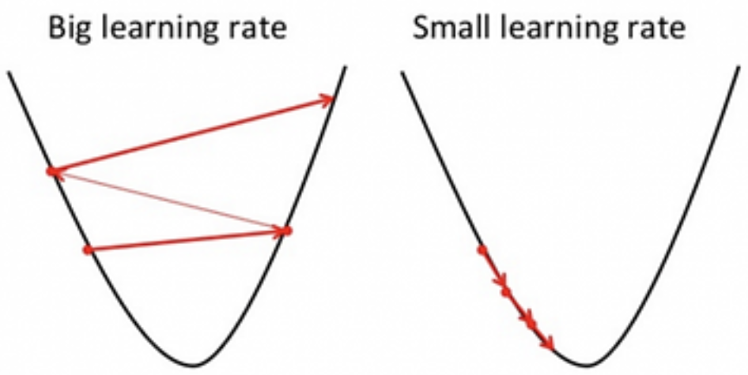
Fig. Learning Rate to reach local minima

Slide 14
Optimization Algorithms
Gradient Descent
Stochastic Gradient Descent
Mini-Batch Gradient Descent
SGD with Momentum
Adagrad (Adaptive Gradient)
AdaDelta
RMSprop
Adam

